Slide 1
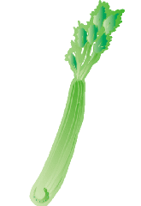
LUNCHBOX: #KIDZSTYLE Add your choices to the family shopping list! CHECK the snacks that will be providing your source of energy for a fun-filled day!
Monday | Tuesday | Wednesday | Thursday | Friday | Add Your Favorite:
PRINTER-FRIENDLY CONTENT

